Slide 1
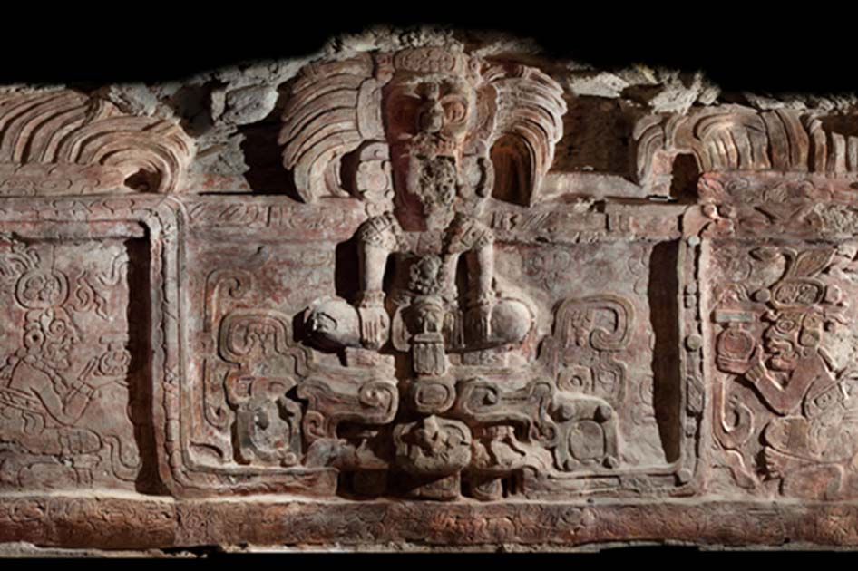
Maya Archaeology Project
Notes:
Our project → support maya arch study
Significance of the research:
Since some ancient cultures do not have written records to study from, archaeology is important for understanding the culture’s history and documenting changes in human societies

Slide 2
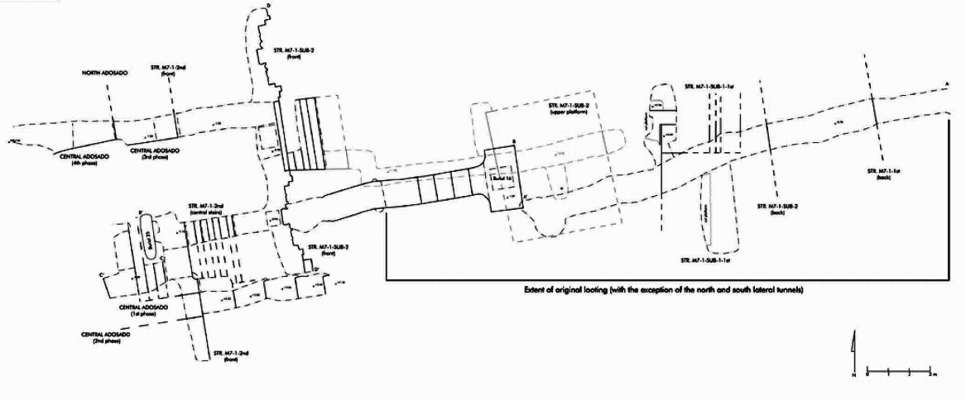
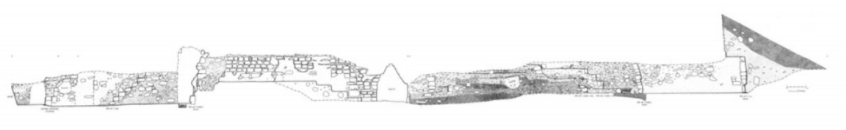
Archaeological tunneling
Notes:
Our project is specifically to support the archaeological tunneling and resolve the challenges that come with it
-maya temples are underground, requires tunneling
-a standard excavation technique used in Mesoamerica
-early attempts to document the explorations [ABOVE]
-drawbacks: time consuming and could be inaccurate
-can’t capture the true complexity of some of these sites due to complex maya structure
-proposed solution would be 3D models

Slide 3
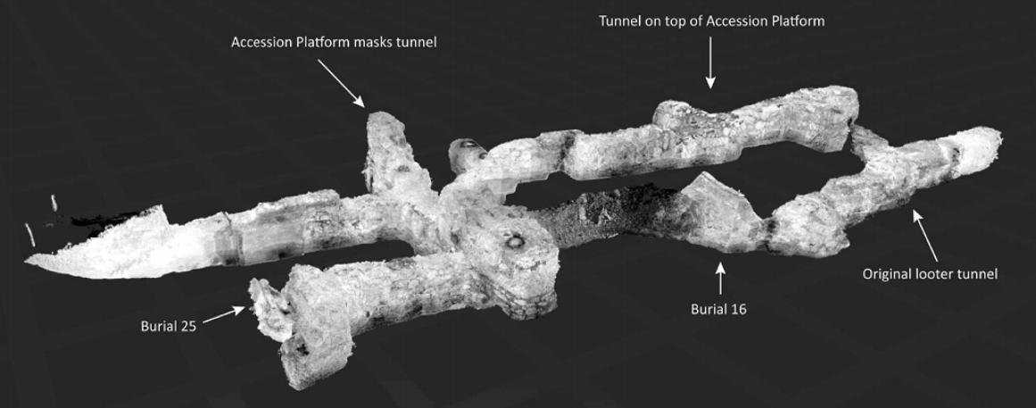
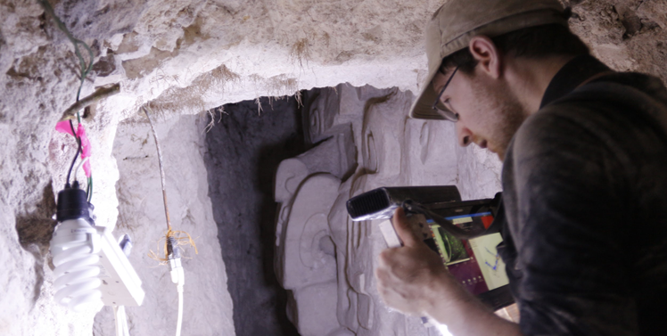
Goals for 3D reconstruction
Accurate
Portable
Real-time results
Affordable
Easy to use
Notes:
For 3D reconstruction to be successful, we need to hit these goals [ABOVE]
2. Too heavy, cant bring inside the tunnel, move around
3. Prevent finding theres problem in the lab
(2. Currently, we have a working system that consists of a handheld rig that supports a tablet, a camera, and a light with a backpack with a laptop and batteries
3. The tablet allows for remote access to a laptop that runs a SLAM algorithm for real-time results. SLAM is algorithm to generate 3D model, which will be explained later
4. Definitely more affordable than LIDAR systems (alternative system to create point cloud of the tunnel).
[ABOVE] So it meets goals, just not accuracy)

Slide 4
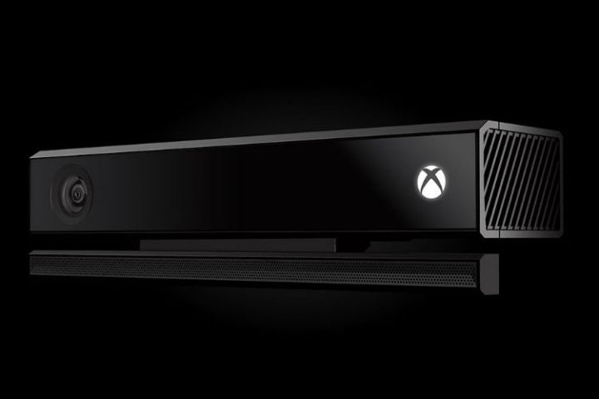
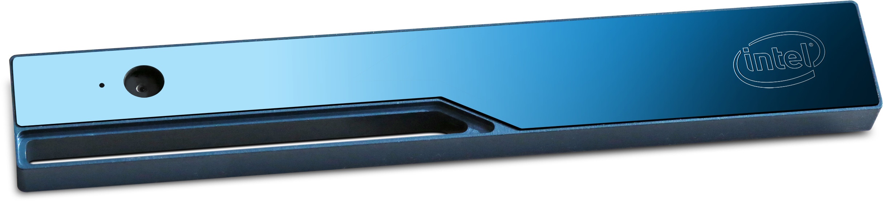
Our Project: Multi-camera
Hardware
Try and test different cameras (Kinect, Realsense)
Software
Research multi-camera SLAM algorithms
Implement algorithms
Notes:
Improving the current system’s accuracy by adding an additional camera
A dual-camera system will improve the current working one by adding robustness and improving accuracy.
Specific goals:
Hardware: try out different cameras (Kinect, Realsense) works with dual-camera
Software: find multi-camera SLAM algorithms, get them to work
(SLAM: Simultaneous Localization and Mapping; algorithm to generate a 3d computer model; (SLAM is traditionally used for robot exploration. A robot running SLAM in an unknown environment will generate a map of its surroundings using sensor data such as RGB images, depth maps, and location (position, heading, etc), and use this map to go around.
SLAM is helpful because the map, which can be a 3d computer model, is generated in real-time))

Slide 5
Milestones
Understand ROS
Build a synchronized feed between two cameras
Test the compatibility of Realsense and Kinect with the multi-camera system
Produce point cloud with appropriate SLAM algorithm
Produce point cloud from live feed
Notes:
Learn ROS to a level where we can record RGB and depth data and replaying through use of ROS and Kinect/Realsense
Explain what is ros: Robot Operating System (ROS) is collection of software frameworks for robot software development); also used for video data processing
We will show that we have done this through a demo of using ros to record
Show a synchronized feed between the two cameras
Get live feed from two cameras.
Sync data from the 2 cameras
Deliverable: Two Live Cameras running with ROS showing RGBD data and sync status to within 5ms delay between two camera
Go in detail for later two

Slide 6


Demo of Current Progress: Recording with Two Cameras Using ROS

Slide 7
Quarter Plan
Milestone 3: Test the compatibility of Realsense and Kinect with the multi-camera system
Deliverable: Document containing Pros and Cons of two systems.
Notes:
Get Pros and Cons; Analyze and conclude
Single camera pros/cons:
Realsense: video quality of these cameras is not as good as the Microsoft Kinect cameras. The data looks noisier than that recorded by the Kinects.
Kinect: They have better video quality but these do not have built in IMUs (an electronic device provides physical measurement of the camera, that measures and reports a body's specific force, angular rate, and ) and are bulkier than realsense

Slide 8
Quarter Plan
Milestone 4: Produce point cloud with appropriate SLAM algorithm
Milestone 5: Produce point cloud from live feed
Notes:
Choose a SLAM Algorithm (works with multiple cameras)
Develop a Suite/API for feeding the SLAM algorithm
Make slam work with the system (input and output)
Generate point cloud from test data of a room
Test: Get LiDAR model of room as ground truth (also used for ground truth of actual maya tunnel)
Test our generated point cloud against the ground truth with Go-ICP script (registration algorithm)
If have time, we plan on going to the Arroyo Tapiado Mud Caves to simulate the environment of the archaeological tunnels
Produce Point cloud from live feed.
Connect live feed to the Suite/API
Generate point cloud for live data
Deliverable 4: 3D model of a room (lab environment)
Deliverable 5: 3D model of live feed

Slide 9
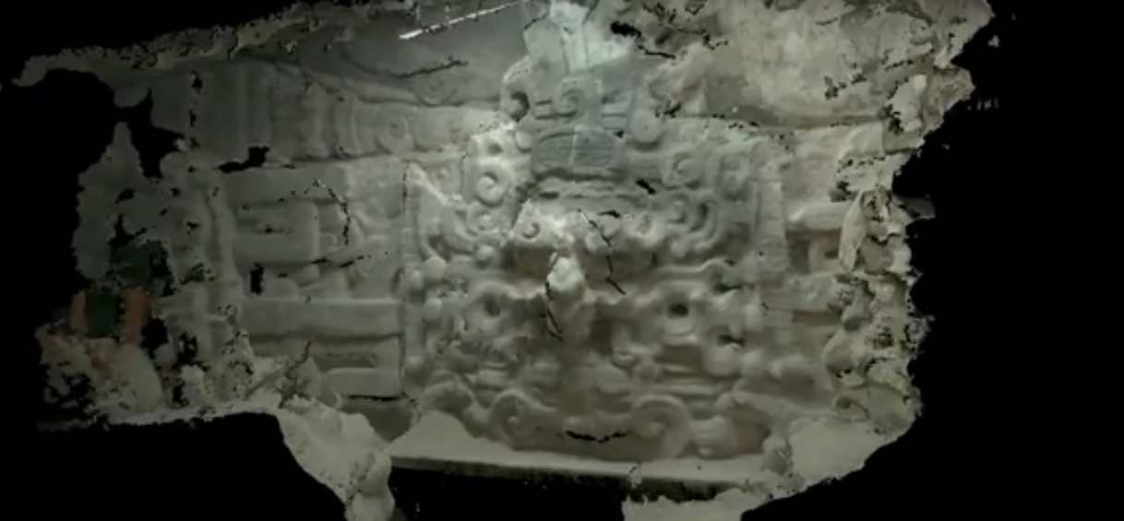
Thank you!
THANK YOU!
Notes:
Maya mask 3D model generated in the past

